Slide 1
Test Driven Development Procedural =>Scenario Based Testing

Slide 2
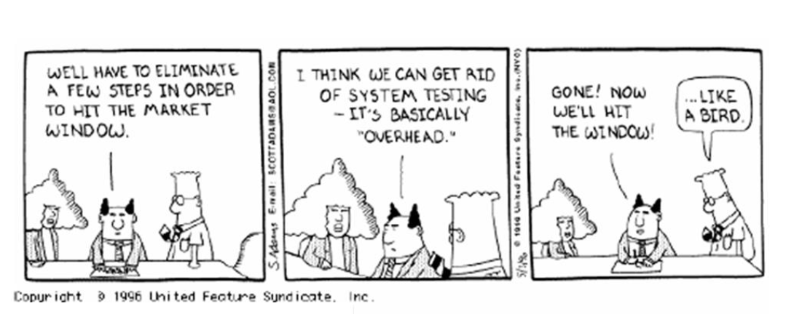
No time for testing!

Slide 3
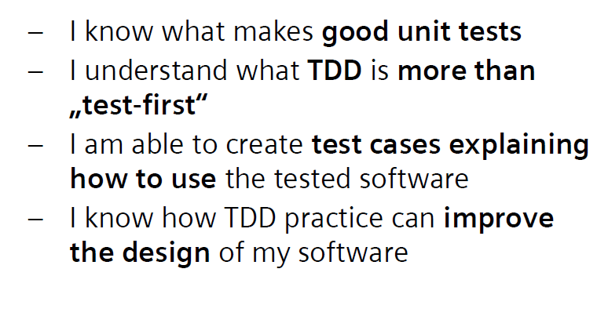
Objectives

Slide 4
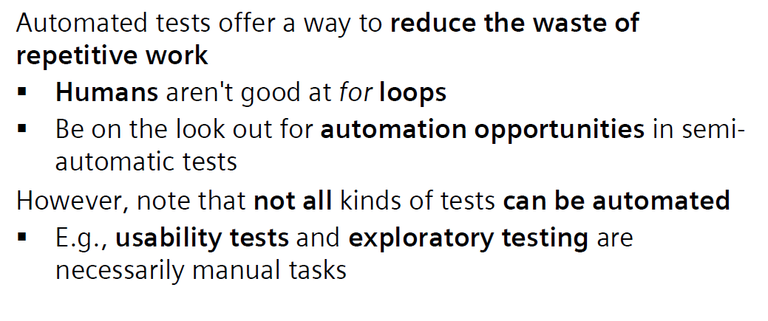
Automation

Slide 5
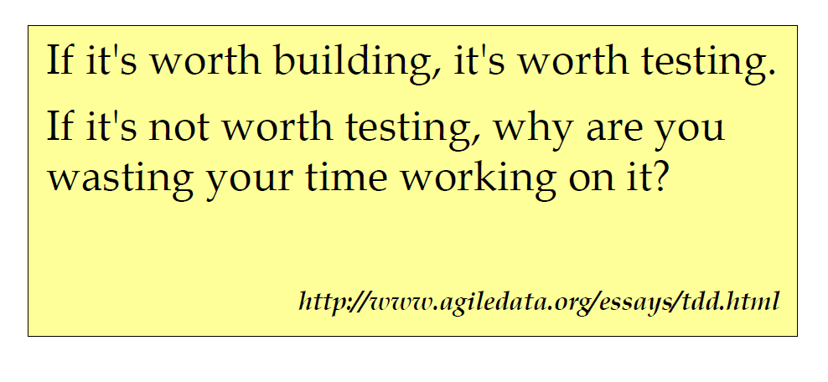
Motivation

Slide 6
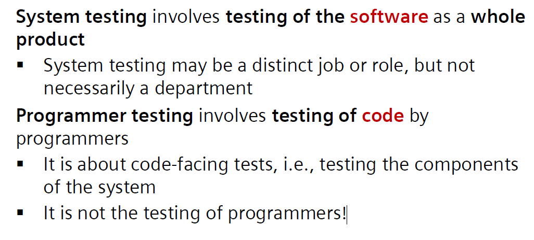
Testing Viewpoint

Slide 7
Testing vs Debugging

Slide 8
Good Unit Tests (GUTs)
▪Are fully automated, i.e., write code to test code
▪Offer good coverage of the code under test, including discontinuities and error-handling paths
▪Are easy to read and to maintain
▪Express the intent of the code under test —they do more than just check it

Slide 9
Not-So-Good Unit Tests
Problematic test styles include...
▪Monolithic tests: all test cases in a single method, e.g., Testor Main
▪Ad hoc tests: test cases arbitrarily scattered across test functions, e.g., Test1, Test2, ...
▪Procedural tests: test cases bundled into a test method that correspond to target method, e.g., TestFootests Foo

Slide 10
Continued…
A test is not a unit test if:
▪It talks to the database
▪It communicates across the network
▪It touches the file system
▪It can't run at the same time as any of your other unit tests
▪You have to do special things to your environment (such as editing config files) to run it.
Tests that do these things aren't bad. Often they are worth writing, and they can be written in a unit test harness. However, it is important to be able to separate them from true unit tests so that we can keep a set of tests that we can run fast whenever we make our changes.
-Michael Feathers, "A Set of Unit Testing Rules"

Slide 11
What to Include
There are a number of things that should appear in tests...
▪Simple cases, because you have to start somewhere
▪Common cases, using equivalence partitioning to identify representatives
▪Boundary cases, testing at and around
▪Contractual error cases, i.e., test rainy-day as well as happy-day scenarios

Slide 12
What to Exclude
There are a number of things that should not appear in tests...
▪Do not assert on behavioursthat are standard for the platform or language —the tests should be on your code
▪Do not assert on implementation specifics —a comparison may return 1but test for > 0—or incidental presentation —spacing, spelling, etc.

Slide 13
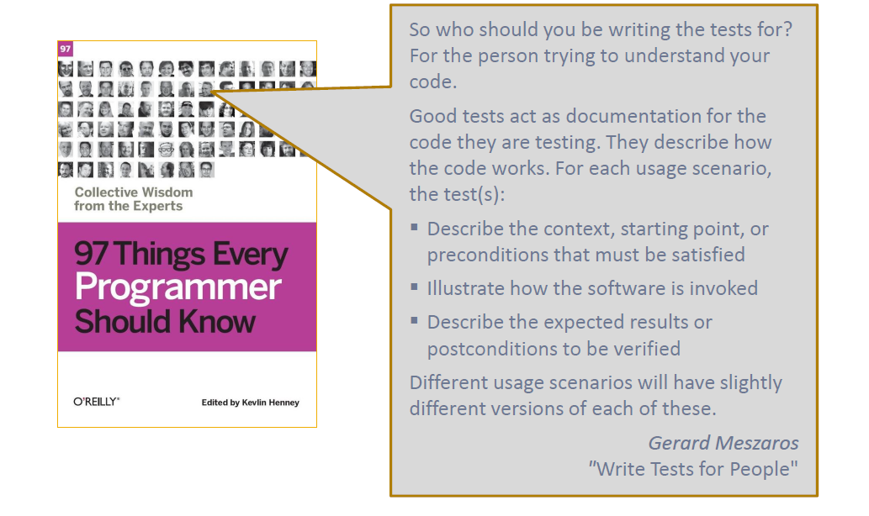

Slide 14
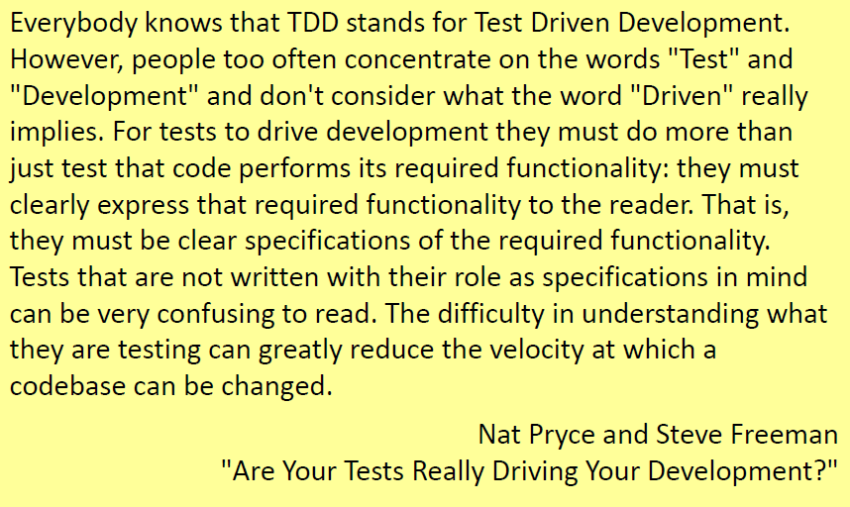
Testing Approach : TDD

Slide 15
TDD complements other design, verification and validation activities
▪The emphasis is on defining a contract for a piece of code with behavioural examples that act as both specification and confirmation
▪The act of writing tests (i.e., specifying) is interleaved with the act of writing the target code, offering both qualitative and quantitative feedback

Slide 16
Three Laws of TDD
1.You can't write any production code until you have first written a failing unit test.
2.You are not allowed to write any more of a unit test than is sufficient to fail; and compilation failures are failures.
3.You are not allowed to write any more production code than is sufficient to pass the one failing unit test.

Slide 17
Key TDD Practices
Testing as discovery and definition
▪Programmers write code-centric tests
▪Test execution is automated
▪Tests are considered to be behaviouralspecifications
▪Functionality is illustrated by example
▪Test and production code are written together—the writing is interleaved
▪Refactoring is continuous and integral

Slide 18
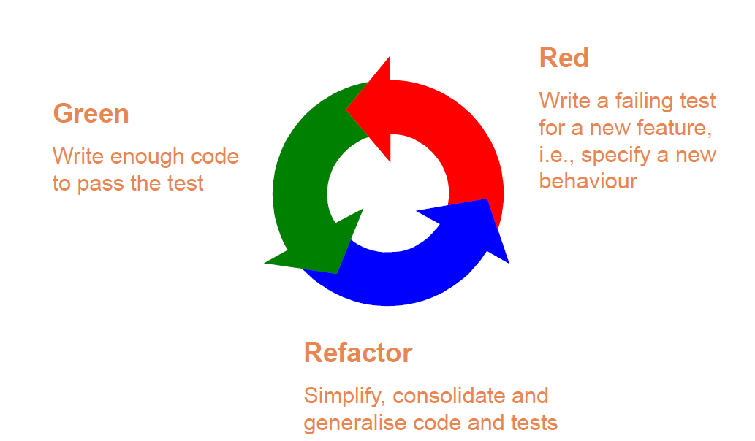
The Test/Spec-First Cycle

Slide 19
Unit vs Integration Tests
Unit tests are on code that is isolated from external dependencies
▪The outcome is based on the code of the test and the code under test
Integration tests involve external dependencies
▪Some portion of a system is necessarily not unit testable; the portion that is not necessarily so is a measure of coupling

Slide 20
Examples

Slide 21

User Story
As a user I want a feature in the application which tells me weather a given year is Leap year or not.

Slide 22
Acceptance Criteria..?
Years not divisible by 4 are not leap years
Years divisible by 4 but not by 100 are leap years
Years divisible by 100 but not by 400 are not leap years
Years divisible by 400 are leap years

Slide 23
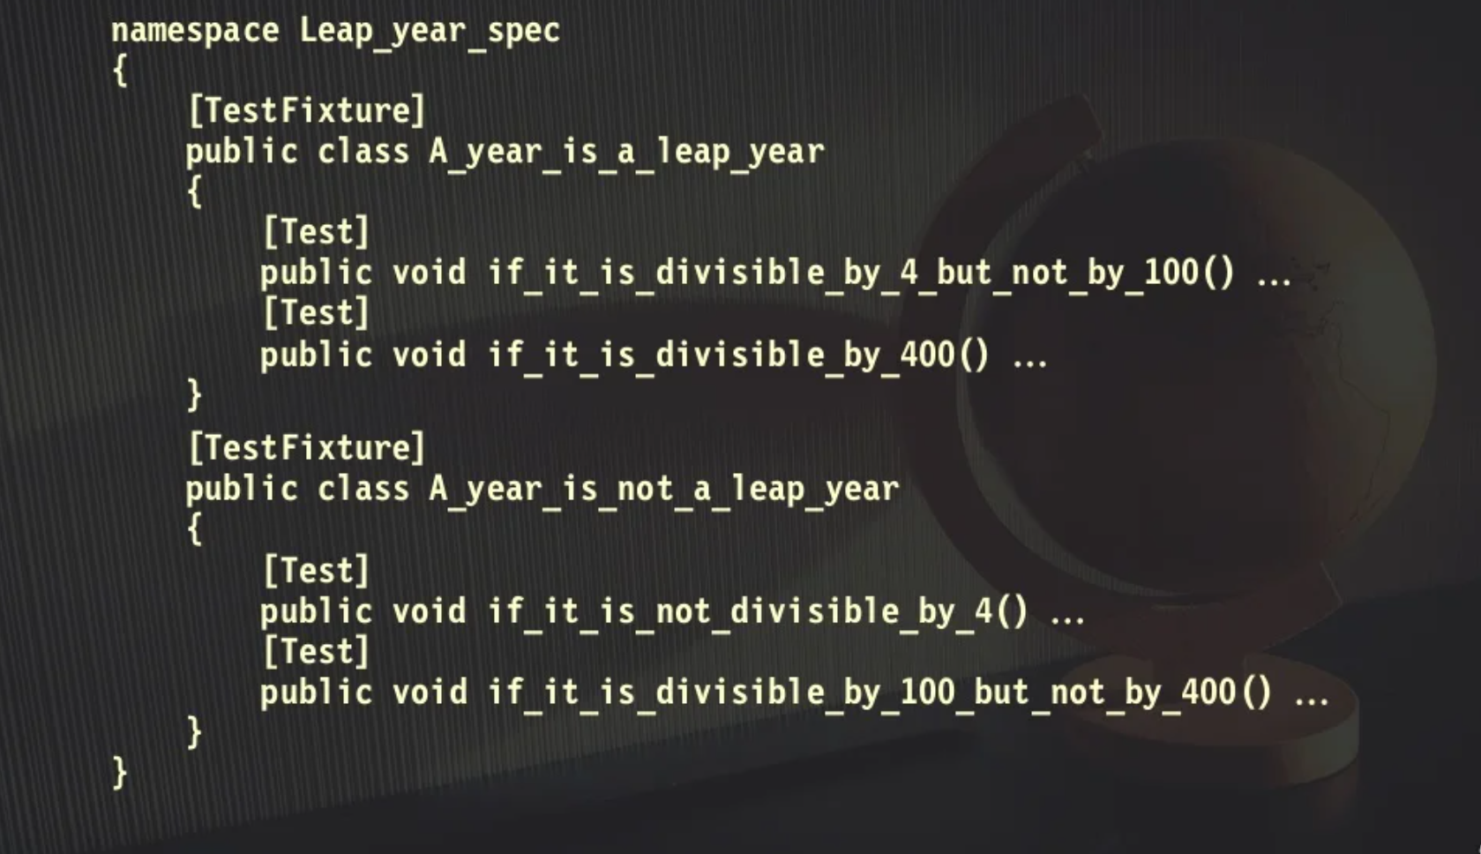
A Good Spec

Slide 24
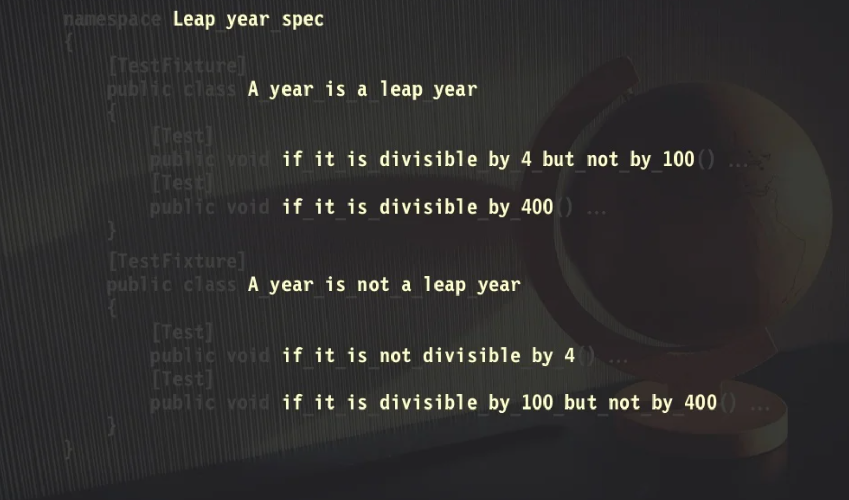
Why..?

Slide 25
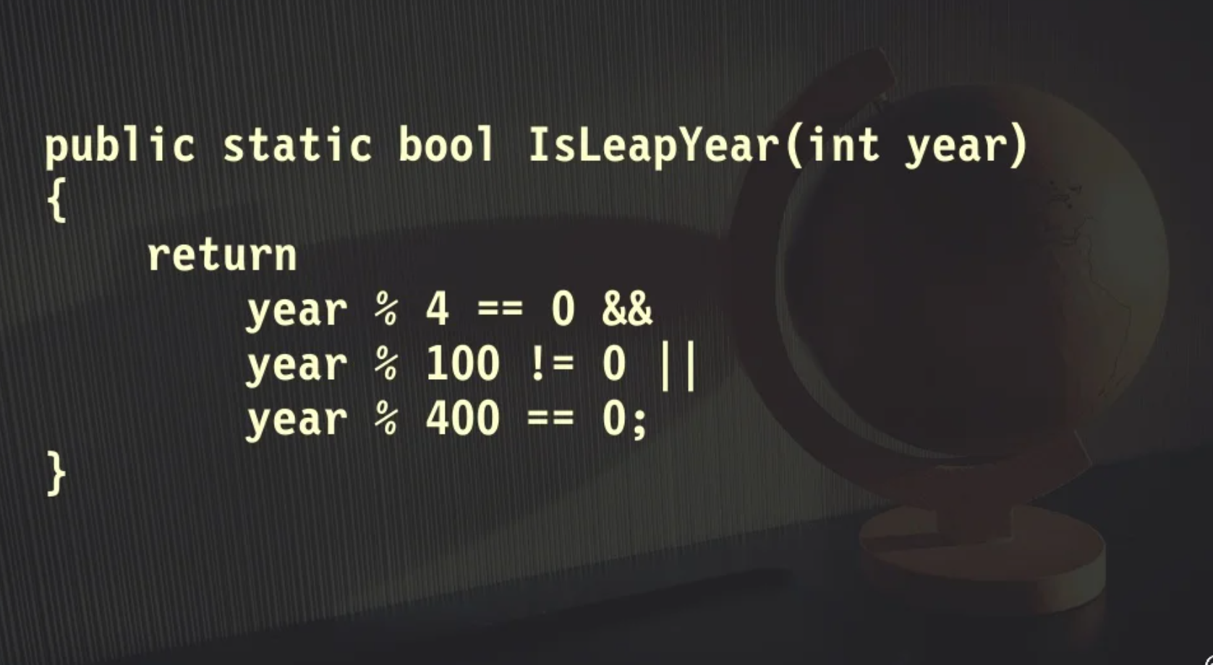
Implementation

Slide 26
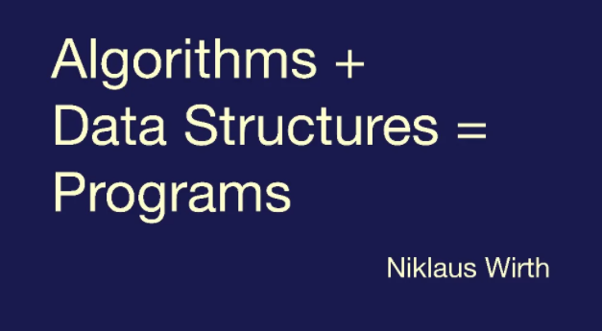
Thanks

